Slide 1
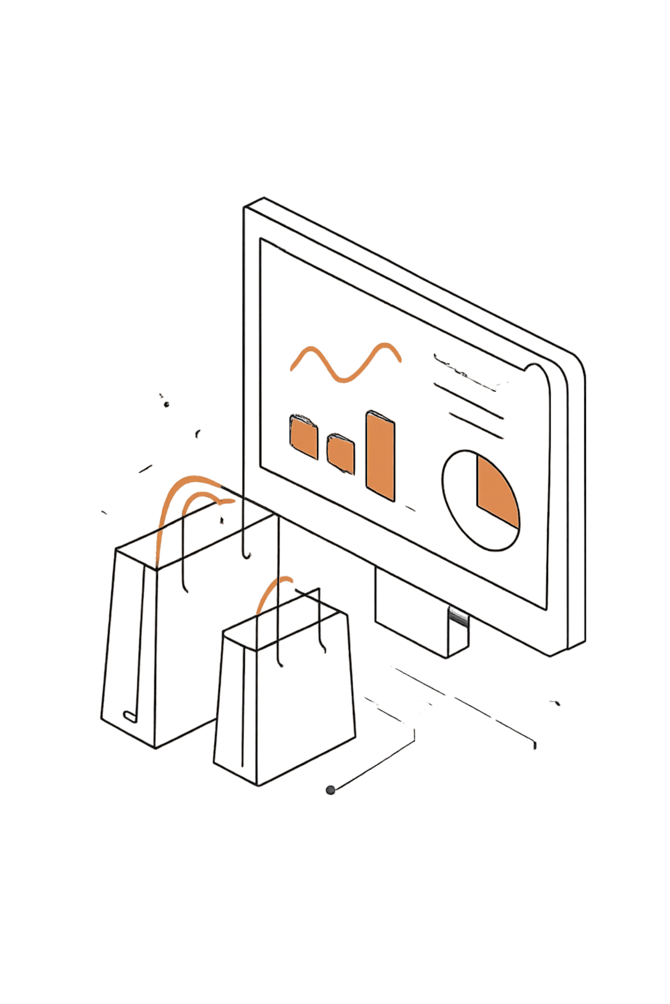
Customer Shopping Behavior Analysis
Uncovering spending patterns, segments, and product preferences from 3,900 transactions

Slide 2

Dataset at a Glance
3,900
18
Purchases
Columns
37
$59.76
Missing Values
Avg. Purchase
Review Rating only
Key Features
Demographics: Age, Gender, Location, Subscription
Purchases: Item, Category, Amount, Season
Behavior: Discount, Promo Code, Frequency, Rating

Slide 3

Data Preparation in Python
01
Load & Explore
Imported via pandas; df.info() and describe()
02
Clean & Standardize
Imputed missing Review Ratings by category median; renamed to snake_case
03
Feature Engineering
Created age_group and purchase_frequency_days; dropped redundant promo_code_used
04
Database Load
Connected to PostgreSQL; loaded cleaned DataFrame for SQL analysis

Slide 4
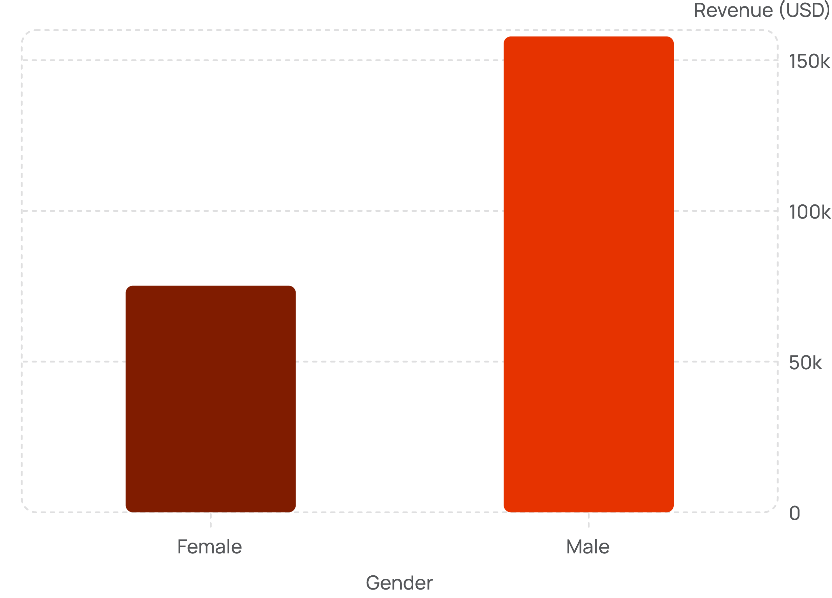
Revenue by Gender & Subscription
Male customers generate 2× more revenue
Subscribers vs. Non-Subscribers
Subscribers (27%)
Non-Subscribers (73%)
1,053 customers · $62,645 total
2,847 customers · $170,436 total

Slide 5
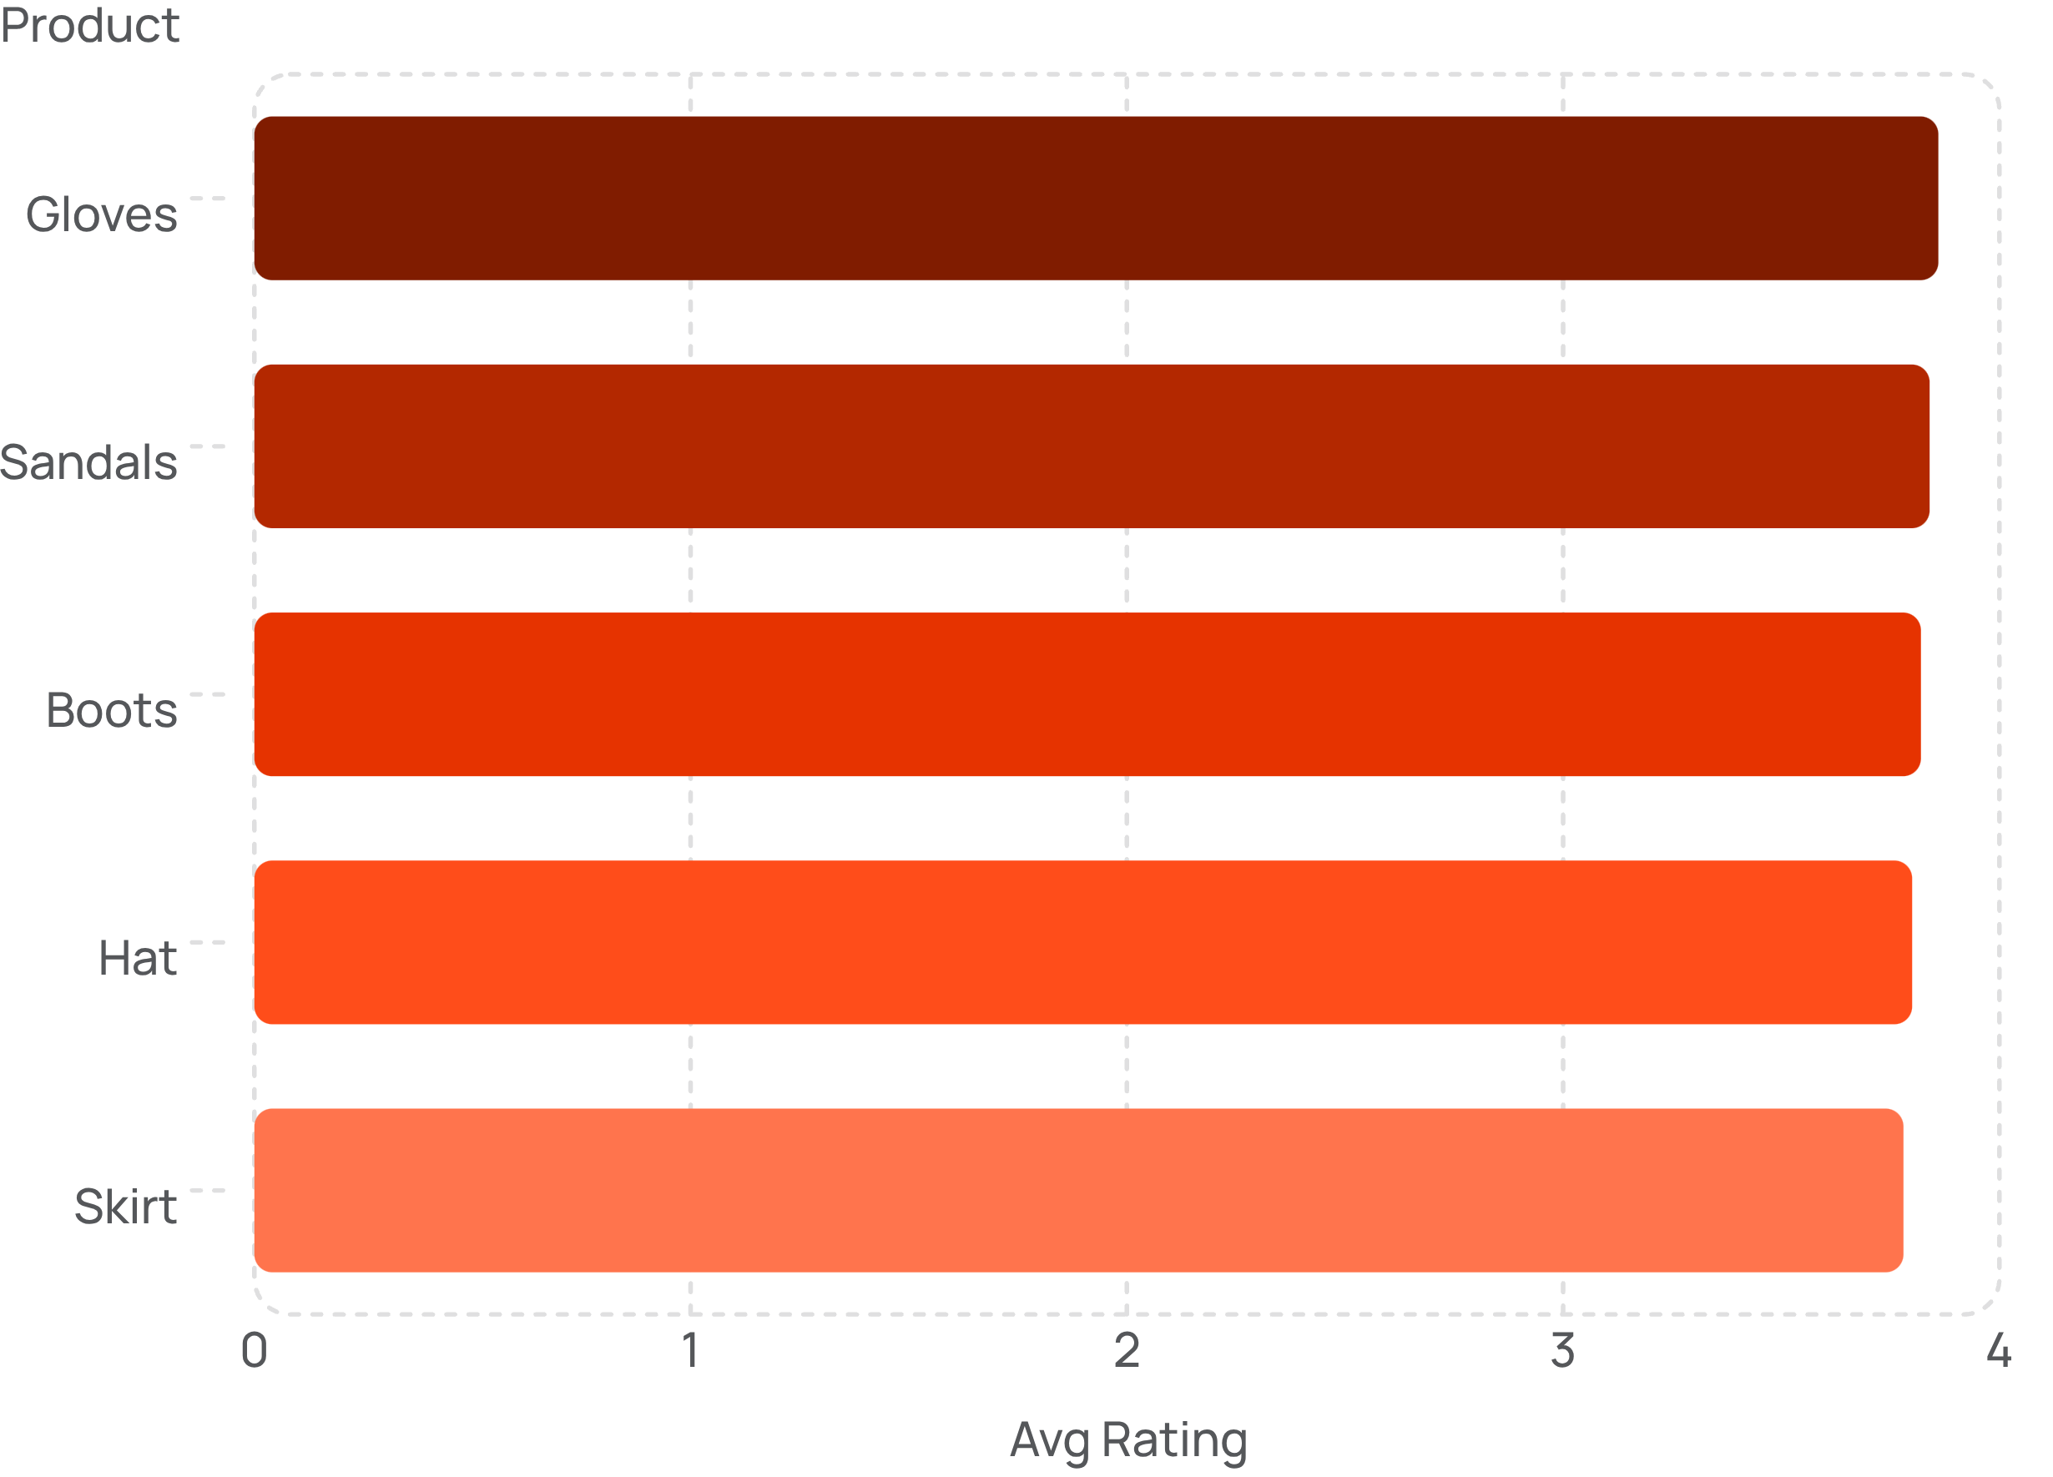
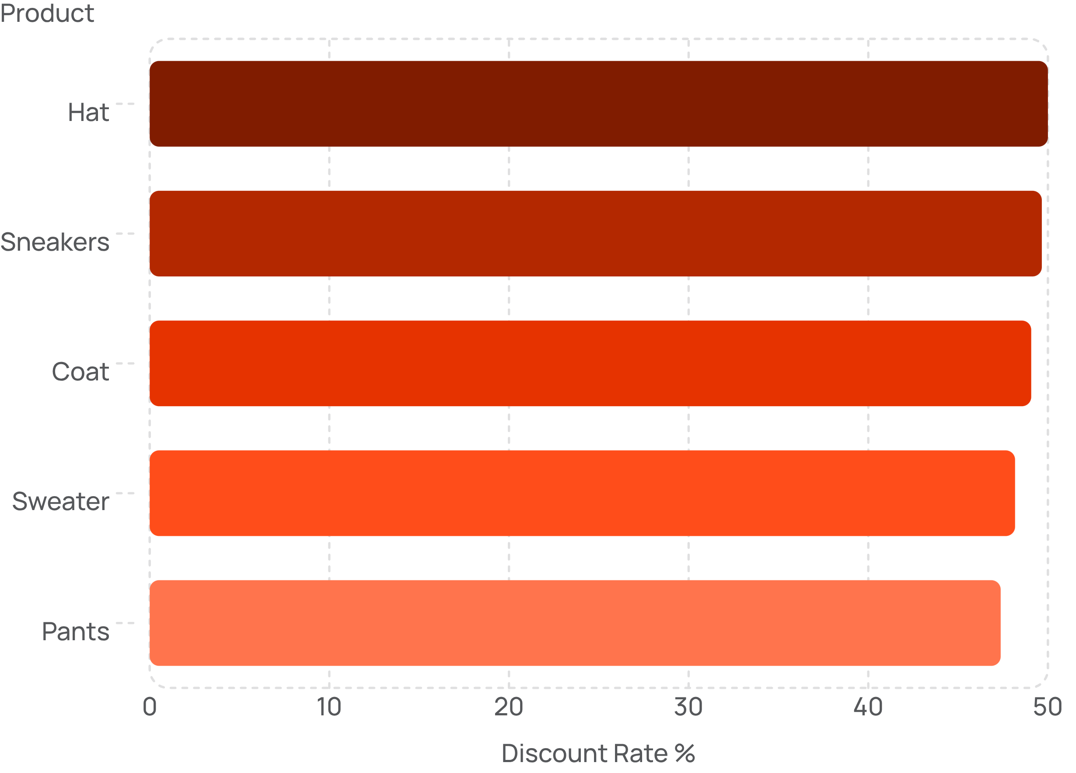
Top Products & Discount Patterns
Top 5 by Review Rating
Most Discounted Products

Slide 6
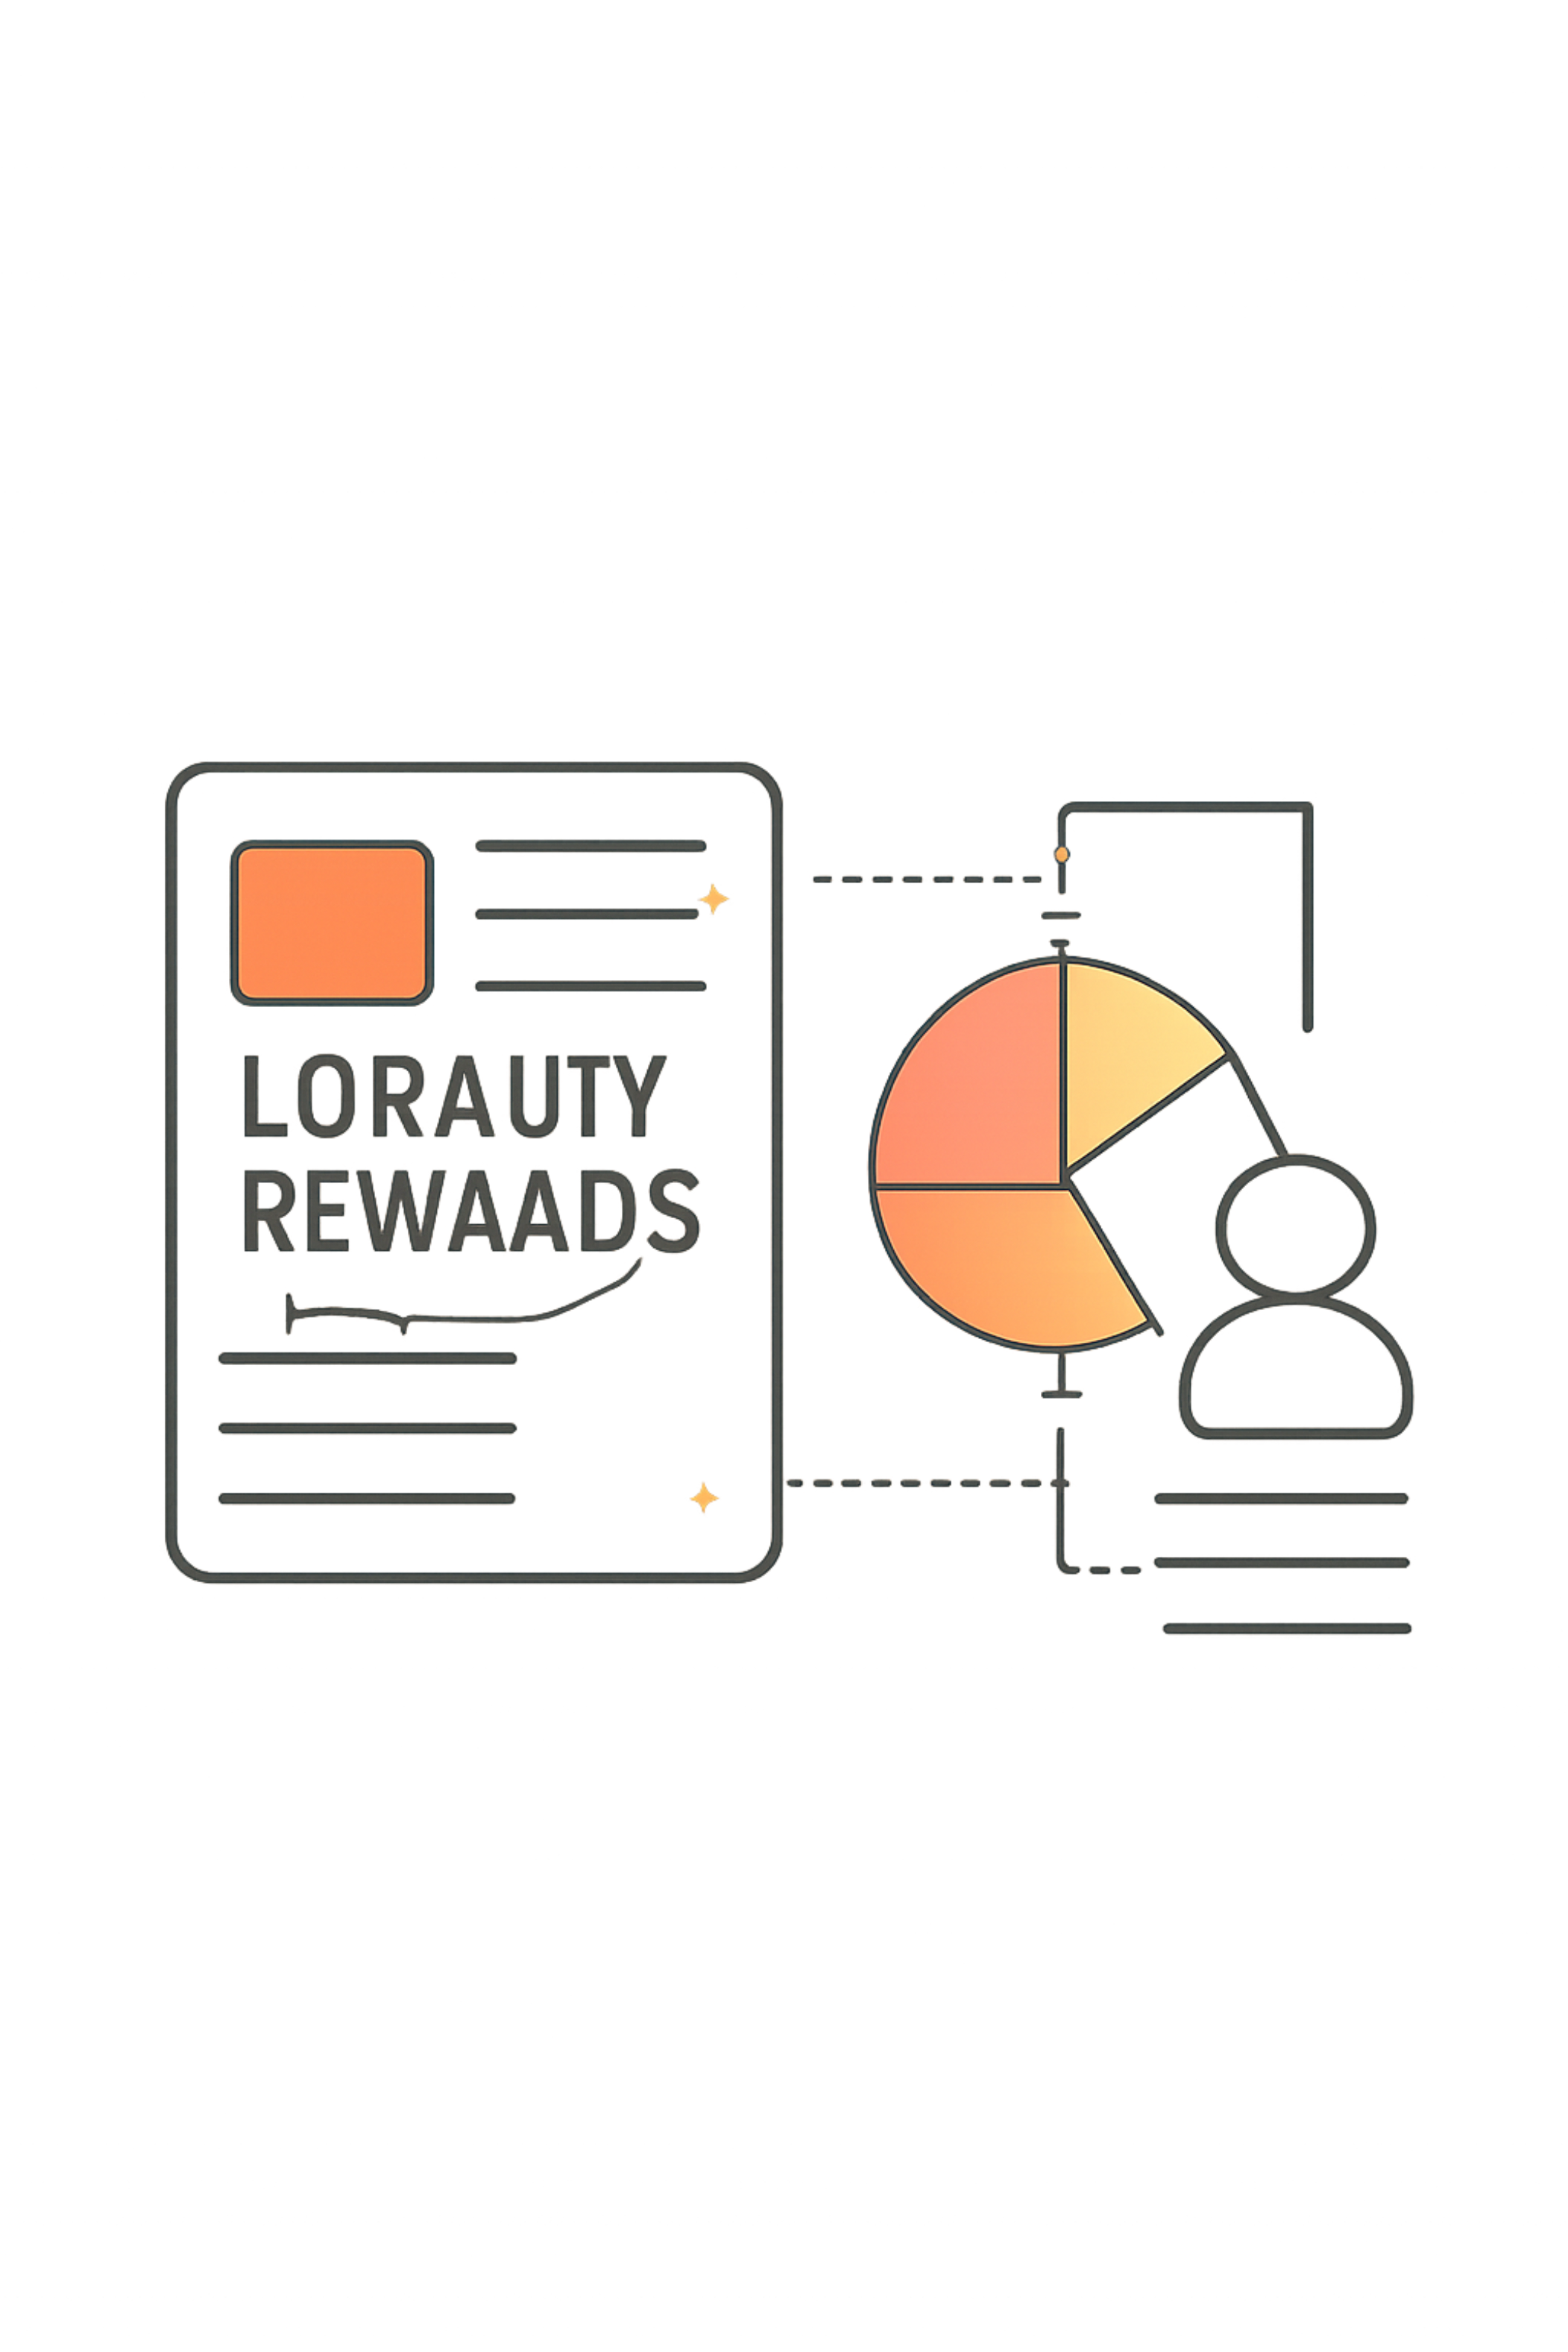

Customer Segmentation
3,116
701
Loyal
Returning
83
New
839 high-spending discount users spent above average purchase amount despite using discounts.

Slide 7
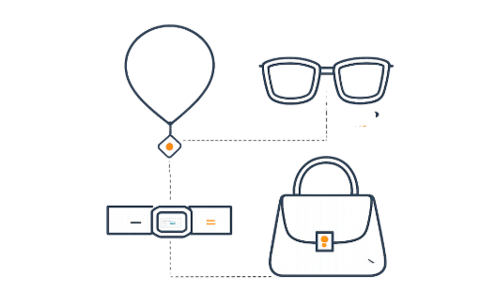

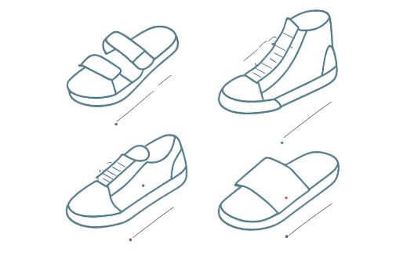
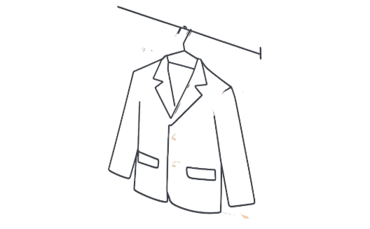
Top Products by Category
Accessories
Clothing
Footwear
Outerwear
Jewelry · Sunglasses · Belt
Blouse · Pants · Shirt
Sandals · Shoes · Sneakers
Jacket · Coat

Slide 8
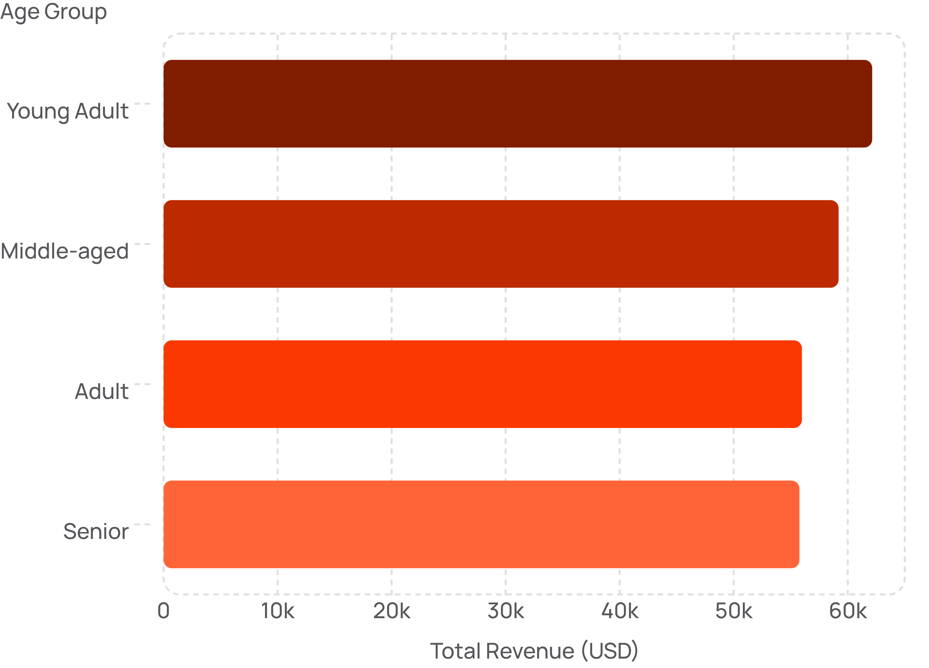
Revenue by Age Group
Key Insights
Young Adults lead in revenue ($62,143)
Revenue is relatively balanced across all age groups
Express shipping averages $60.48 vs. Standard $58.46

Slide 9
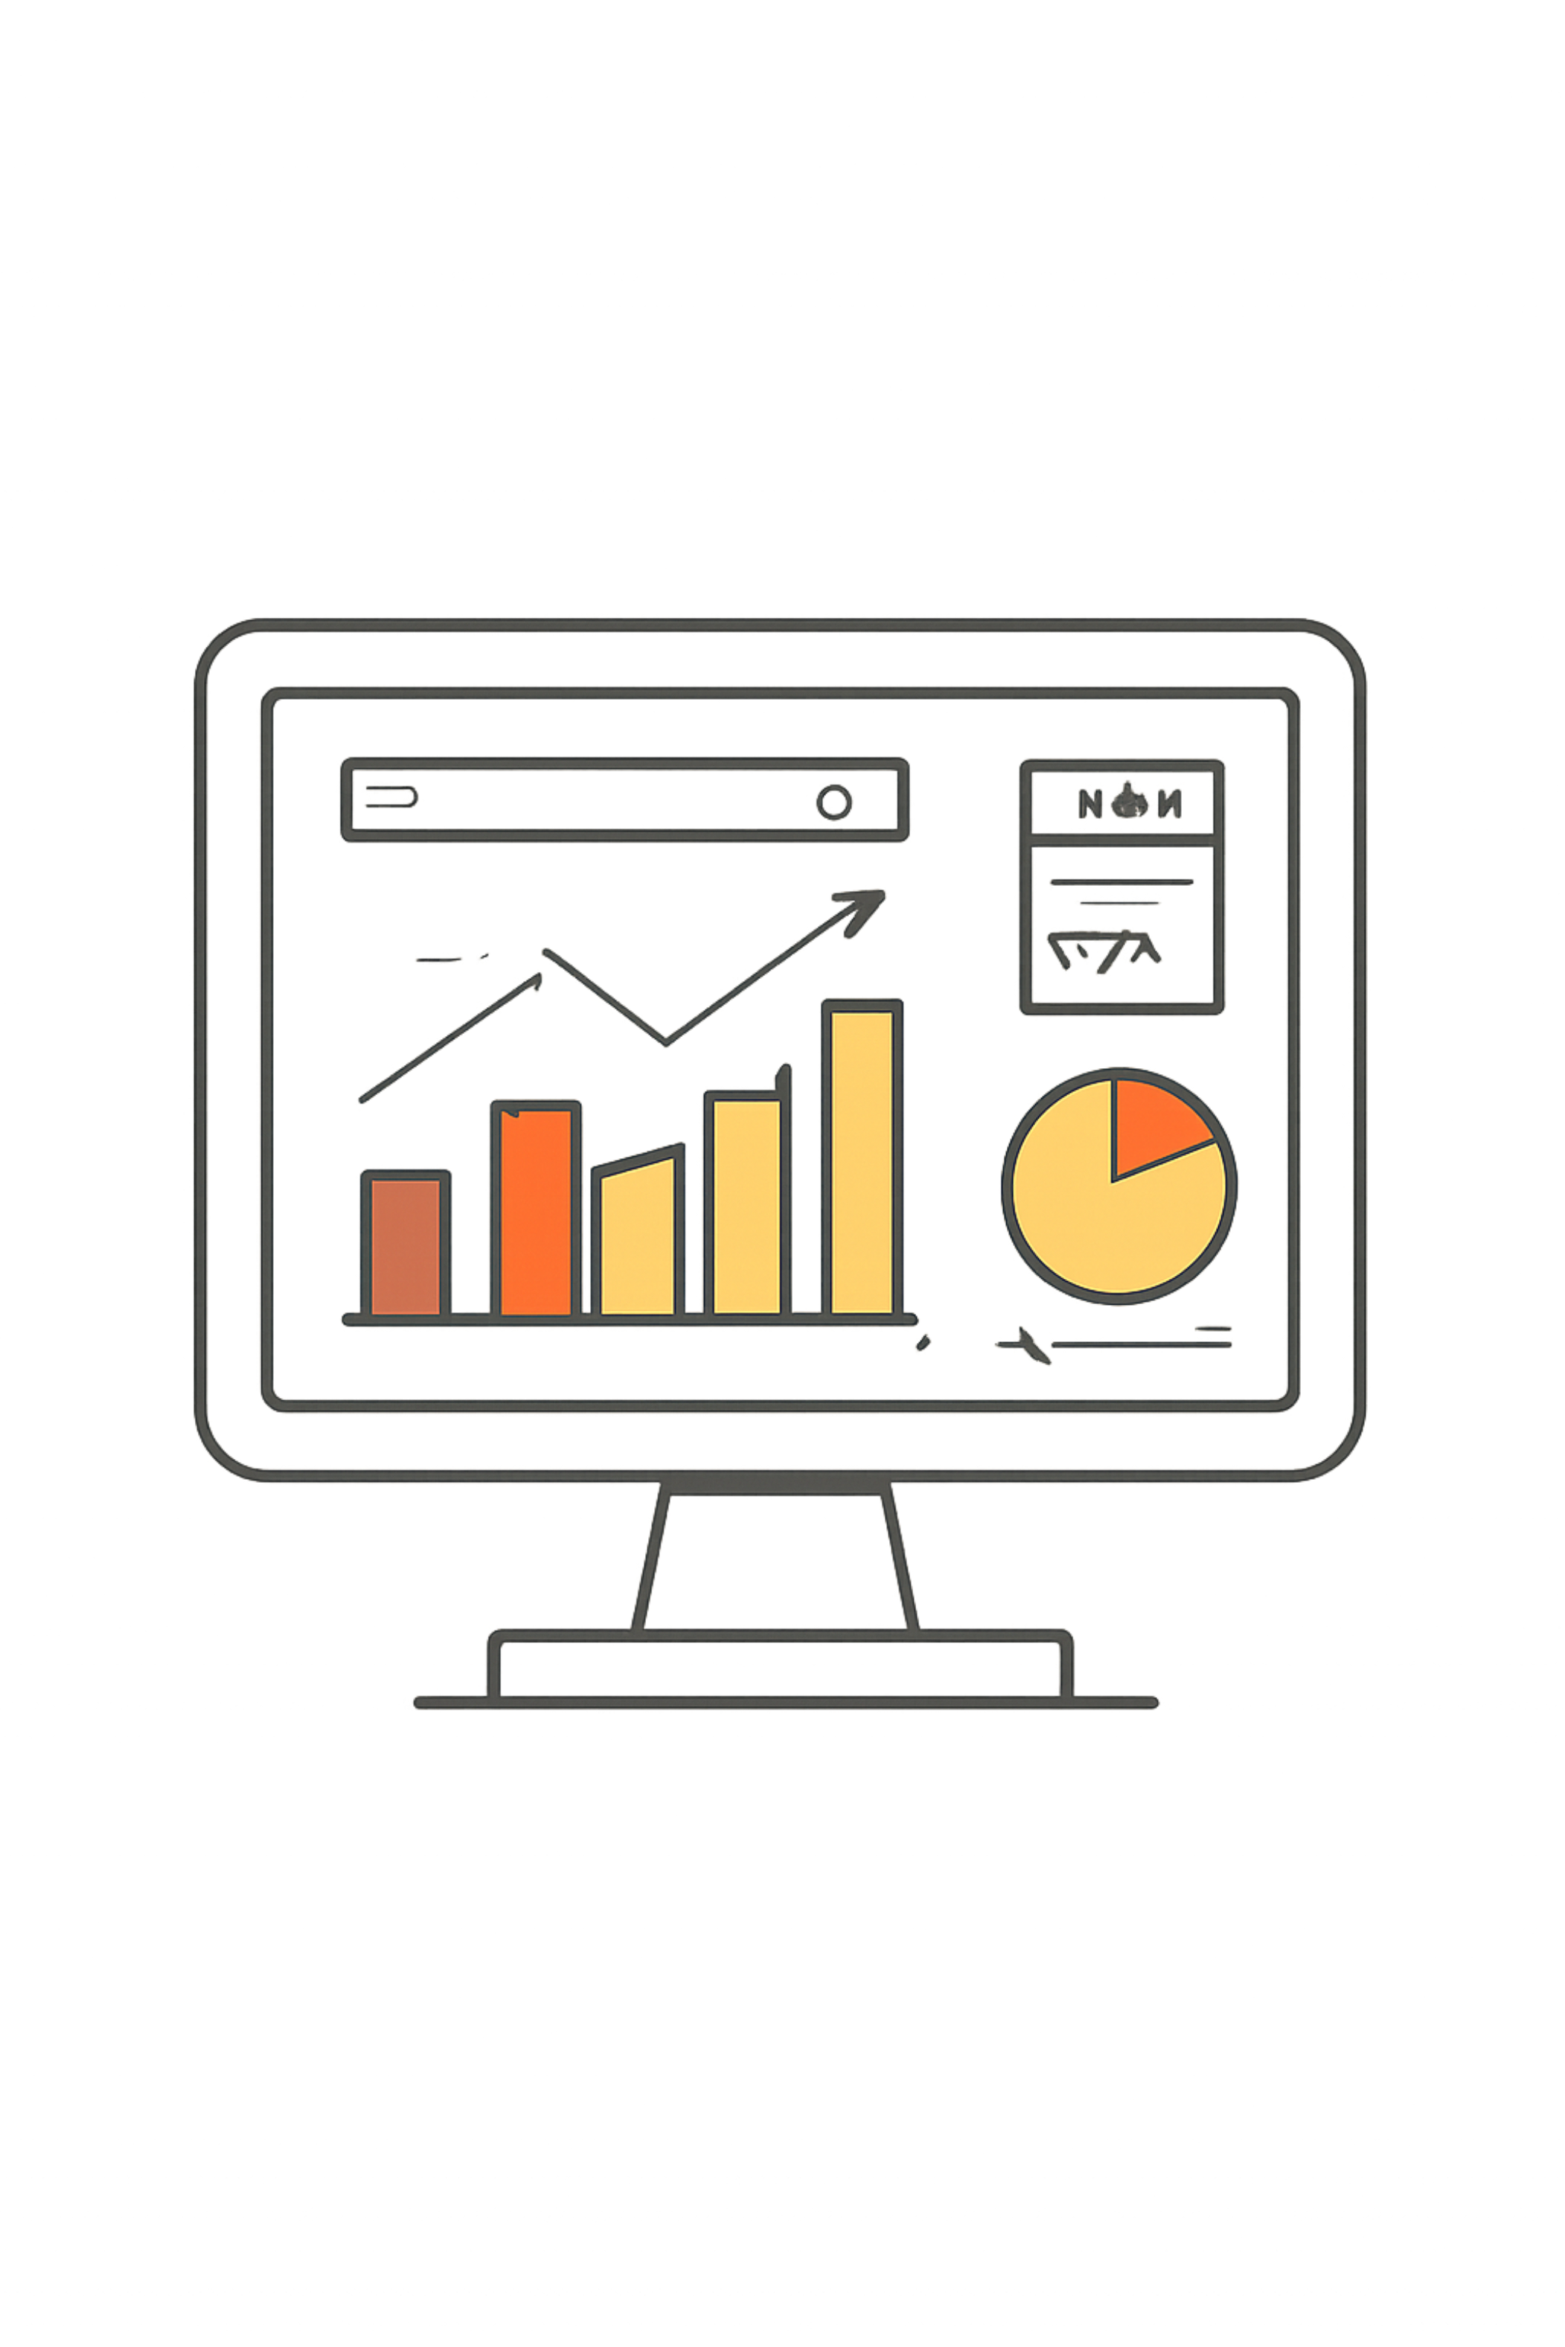
Power BI Dashboard
3.9K Customers
$59.76 Avg Purchase
3.75 Avg Rating
27% Subscribers
Filters: Subscription, Gender, Category, Shipping Type · Visuals: Revenue by Category, Sales by Age Group

Slide 10

Business Recommendations
Boost Subscriptions
Promote exclusive subscriber benefits
Loyalty Programs
Reward repeat buyers → Loyal segment
Review Discount Policy
Balance sales lift with margin control
Product Positioning
Highlight top-rated, best-selling items
Targeted Marketing
Focus on high-revenue age groups & express-shipping users

